Slide 1
Interest Rates

Slide 2
Simple interest is determined by multiplying the daily interest rate by the principal by the number of days that elapse between payments.
Simple Interest = P × I × N
where:
P=principle
I=daily interest rate
N=number of days between payments

Slide 3
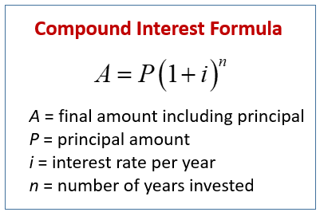
Compound interest (or compounding interest) is interest calculated on the initial principal, which also includes all of the accumulated interest of previous periods of a deposit or loan.

Slide 4
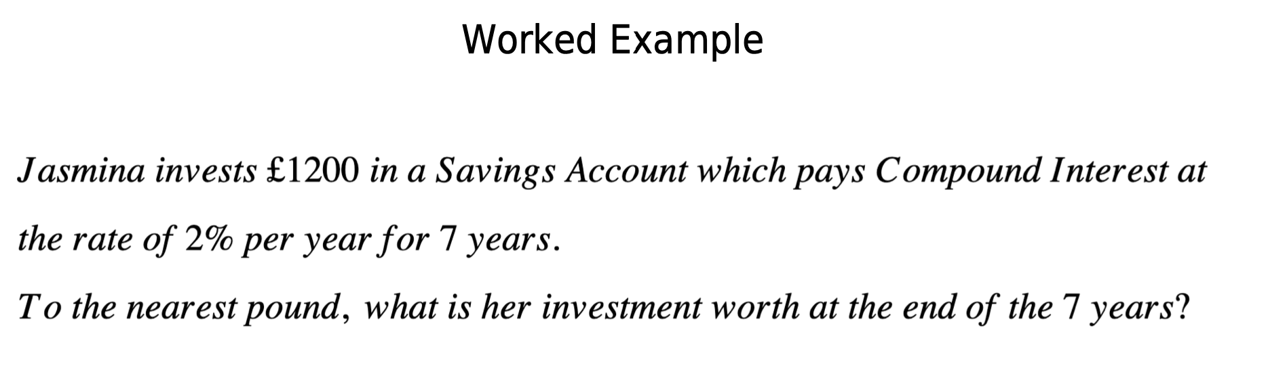
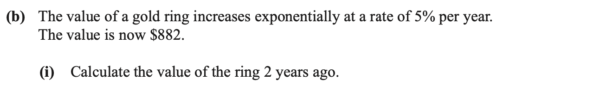

Slide 5
